Slide 1

DF
LECTURE
Windows File System
Diploma in CSF/IT
Year 2/3 (2022/23), Semester 4/6
Digital Forensics
5
Notes:
Left-hand Bar – Replace FSP by your module code and X by the lecture number.
Replace Lecture Title
Replace < Module Name >
Replace Year and Semester if necessary

Slide 2
Objectives
At the end of this, you will get to know more about:
The concept of partitioning
Disk structure
The structure of Master Boot Record
Master boot code
Partition table
Windows partition layout

Slide 3
Primary Partitioning
Primary partitioning
The subdividing of a hard disk drive.
A single hard disk can have up to 4 primary partitions.
If there are multiple operating systems on the disk, each one is typically assigned to its own primary partition.

Slide 4
Volumes vs Partitions
A partition is a collection of (physically) consecutive sectors.
A volume is a collection of (logically) addressable sectors.
Data contained in the volume may appear consecutive, but only logically.
Typically when a partition is created on a single hard disk, it automatically becomes a volume and is assigned a drive letter (e.g. C:, D:, etc.).

Slide 5
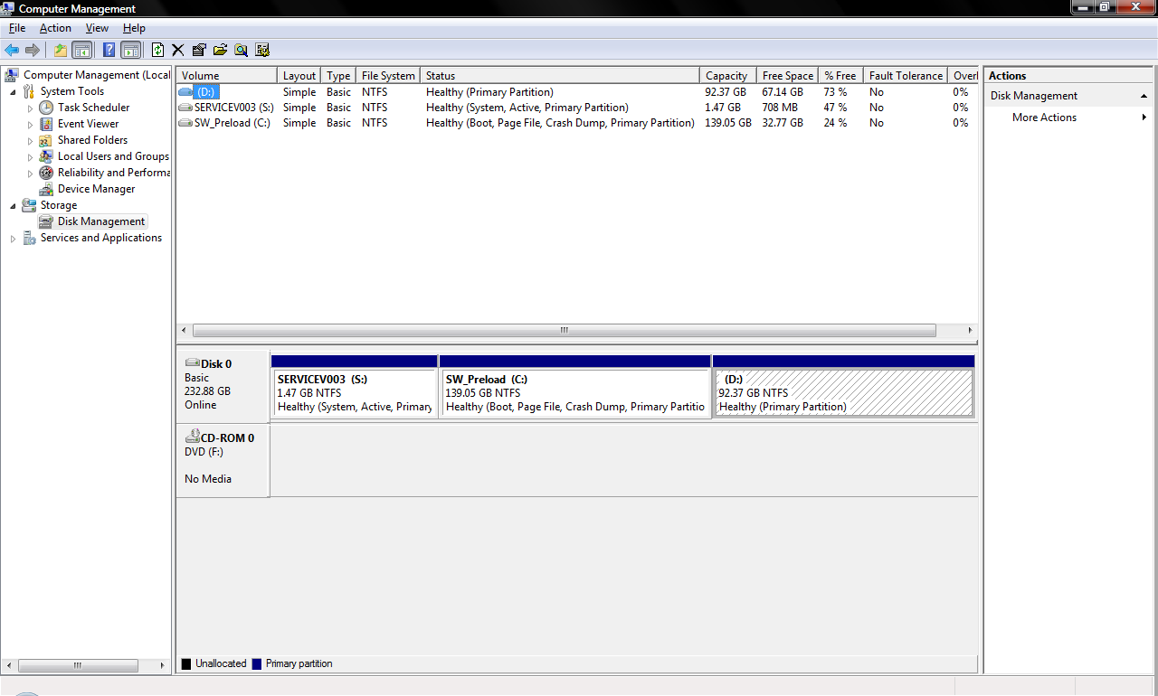
Physical and Logical Drives
Physical device - 1 physical drive, Disk 0
Logical volume – 3 logical volumes, C, D and S Drives

Slide 6
Extended Partitioning
Extended partition
One of the 4 primary partitions may be subdivided into multiple partitions (volumes), therefore allowing 2 or more volumes to exist within one partition.
This subdivided partition is referred to as an extended partition.

Slide 7
What is a File System?
File systems provide a mechanism for users to store data in a hierarchy of files and directories.
It consists of structural and user data that are organized such that the computer knows where to find them.
Windows File System:
FAT 12/16/32 (File Allocation Table)
NTFS（New Technology File System）
ReFS (Resilient File System)
https://www.youtube.com/watch?v=mzUyMy7Ihk0
Notes:
ReFS
ReFS (Resilient File System) is the latest development of Microsoft introduced with Windows 8 and now available for Windows 10. The file system architecture absolutely differs from other Windows file systems and is mainly organized in a form of the B+-tree. ReFS has high tolerance to failures due to new features included into the system. And, namely, Copy-on-Write (CoW): no metadata is modified without being copied; data is not written over the existing data, but into new disk space. With any file modifications, a new copy of metadata is stored into free storage space, and then the system creates a link from older metadata to the newer one. Thus, the system stores significant quantity of older backups in different places providing easy file recovery unless this storage space is overwritten.
https://www.ufsexplorer.com/articles/file-systems-basics.php

Slide 8

File Allocation Table
https://www.youtube.com/watch?v=V2Gxqv3bJCk&list=PLdWRtaJr2DkAIrj-PEzhLy-4faRkhY_2m&index=7

Slide 9
File System
Purpose of file system:
Track the name of the object (file/folder).
Track the starting cluster/allocation block of the object.
Track the fragmentation of the object (noncontiguous allocation blocks/clusters).
Track allocation blocks/cluster status on the volume.

Slide 10
Master Boot Record (MBR)
MBR is the 512-bytes boot sector that is the first sector (absolute sector 0) of a partitioned data storage device such as a hard disk.
It holds a disk's primary partition table (4-entries).
Each partition table entry list the starting sector, the number of sectors, and the type.
It tells the computer how the hard drive is partitioned, and how to load the operating system(s).
It also holds the boot instructions.

Slide 11
Master Boot Record (MBR) –cont.
Partition Table
Entry 1 – 1st partition
MBR (512 bytes)
Entry 2 – 2nd partition
Entry 3 – 3rd partition
Entry 4 – 4th partition
Master Boot Code
Partition table is located in the 1st sector of the drive (MBR).
Each partition entry is 16 bytes long.

Slide 12
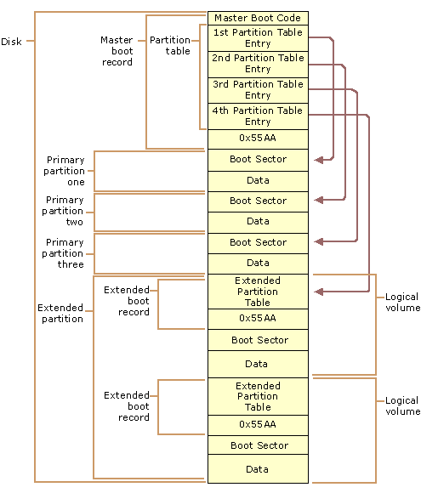
Disk Structure

Slide 13
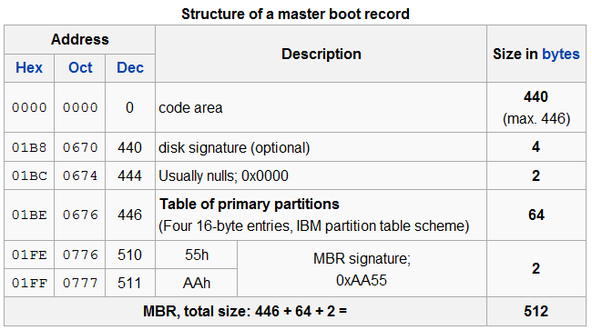
Master Boot Record (MBR) – cont.
Master Boot Code
0x55AA

Slide 14
Master Boot Record (MBR) – cont.
The master boot code performs the following:
Scans the partition table for active partition.
Finds the starting sector of the active partition.
Loads a copy of the boot sector (in VBR) from the active partition into memory (RAM).
Transfer control to the executable code in the boot sector.

Slide 15
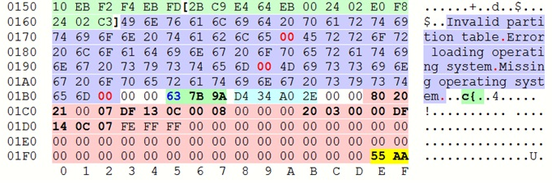
Master Boot Record (MBR) – cont.
Start of Partition Table
MBR Signature
The partition table at offset 0x1BE in the MBR is used to identify the type and location of partitions on a hard disk, and has a standard layout independent of any operating system.

Slide 16
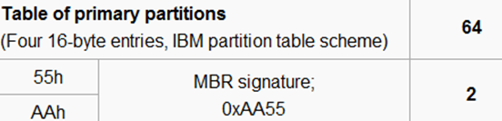
Master Boot Record (MBR) – cont.
At the end of the MBR is a two-byte structure called a signature word or end of sector marker, which is always set to 0x55AA.
If the signature word is not 0x55AA, hard drive will not boot until they are changed to this hex value.
0x55AA

Slide 17
Partition Table
The partition table holds information to identify the type, size and location of the partition, and whether it is active or not.
There can be either four primary or three primary and one extended partitions. Each partition table entries is 16 bytes long.
In each entry in the partition table is:
0x0 - Boot Indicator: 0x00 inactive partition, 0x80 active partition
0x1 - Cylinder/Head/Sector address of first sector in the partition, 3 bytes
0x4 - System ID: 0x07 NTFS
0x5 - CHS address of last sector in the partition, 3 bytes
The last 4 bytes represents the size of the partition in number of sectors.

Slide 18

Boot Sectors of a partitioned hard disk drive
Example:
The drive has two partitions, each partition contains its own VBR.
Each VBR contains information about its partition.
When BIOS hands control over to the boot sectors, the MBR takes control and starts the boot process and refers to the VBR to point it to the partition information.

Slide 19
Windows XP Partition Layout
Sector
0
63
Windows C:\ Partition
Unallocated Space
MBR (Partition Table)
The starting sector for Windows XP is sector 63.
63 is one track of a physical disk image and the first partition was selected to start after track 0.

Slide 20
Windows 7 (and later OS) Partition Layout
Sector
0
2048
~1200 MB Later
System Partition
Windows C:\ Partition
MBR (Partition Table)
Unallocated Space
In Win 7, the 1st partition is not C: but called SYSTEM_DRV
This partition is a part of boot process that contains utilities, and a registry hive called Boot Configuration Data (BCD) to aid hardware/firmware to boot Windows OS.
The 2nd partition is C:\.

Slide 21
Summary
A single hard disk can have up to 4 primary partitions, or 3 primary and 1 extended partition.
A partitioned disk has a master boot record that contains information about partitions on the disk.
The partition table holds information to identify the type, size and location of the partition, and whether it is active or not.
Windows 7 (and later OS) has a system partition starting at sector 2048.

Slide 22
Reference Books
EC-Council, Computer Forensics: Investigating Hard Disks, File and Operating Systems, Course Technology, Cengage Learning.
Brian Carrier, (2005). File System Forensic Analysis. Addison-Wesley, Pearson Education.
Albert J. Marcella, Jr. Frederic Guillossou (2012). Cyber Forensics – From Data to Digital Evidence. Wiley Corporate F&A.
Notes:
Publisher: Cisco Press, Thomson Learning

